Slide 1
Agenda
Module 1: Introduction
Module 2: Commands
Module 3: Data And Streams
Module 4: Pipeline Introduction
Module 5: Introduction To Data Types
Module 6: Advanced Pipeline Operations
Module 7: Modules Introduction
Module 8: Advanced Data Types
Module 9: Functions, Scripts & Scope
Module 10: Flow Control

Slide 2
Module 9: Functions, Scripts & Scope
Lesson 1: Introduction to Scripts
Launching a script
Execution Policies
Comments
Profiles
Command Lookup Precedence
Lesson 2: Functions
Function Overview
Function Parameters
Lesson 3: Scopes
Scope Overview
Scope Modifiers
Dot notation
Notes:
Strong typing and default values for Params (hook for part 2 with advanced mention)

Slide 3
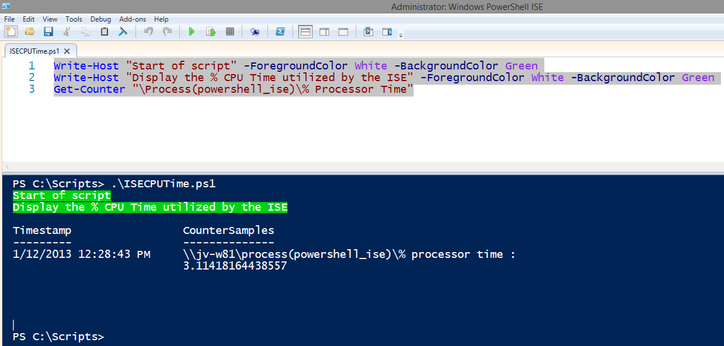
Example: Simple script
Notes:
Slide notes: single discussion slide to show scripts are like functions named to files on the disk

Slide 4
Running a Script
Full path and file name
PS C:\> c:\scripts\script.ps1
Script in current directory
PS C:\Scripts> .\script.ps1
Spaces in path (tab completion helps)
PS C:\> & “c:\scripts\my script.ps1”
Script is in environment path
PS C:\> Script.ps1

Slide 5
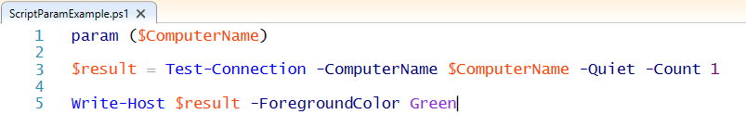
Param Statement
Must be first statement in script, except for comments
Parameter values are available to commands in script
Param Statement
Parameter
Parameter Value
PS C:\scripts> .\ScriptParamExample.ps1 -ComputerName localhost
True
PS C:\scripts> .\ScriptParamExample.ps1 -ComputerName DoesNotExist
False
PS C:\scripts>

Slide 6
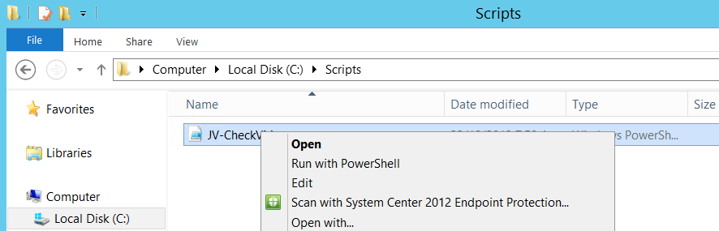
Running a Script with the Mouse
Script files cannot be double clicked to run
Run with PowerShell option:
Right-click script
Select Run with PowerShell

Slide 7
Execution Policy Levels
Restricted
AllSigned
RemoteSigned
Unrestricted
Default in 2008R2 and below.
Scripts cannot be run
PowerShell interactive-mode only
Runs a script only if signed
Signature must be trusted on local machine
Default in 2012R2 and Beyond. (Recommended Minimum)
Runs all local scripts
Downloaded scripts must be signed by trusted source
All scripts from all sources can be run without signing
Notes:
Security Convenience not actual security…-ExecutionPolicy Bypass
https://blog.netspi.com/15-ways-to-bypass-the-powershell-execution-policy/

Slide 8
Execution Policy Scope
AD Group Policy – Computer
AD Group Policy – User
Process
Registry – Computer
Affects current PowerShell Host session only
Lost upon exit of session (i.e. host process)
Console or ISE Command-line Parameter: i.e.: c:\> powershell.exe –executionpolicy remotesigned
Affects all users on computer
Stored in HKLM registry subkey (Admin access needed to change)
Registry – User
Affects current user only
Stored in HKCU registry subkey
Affects all users on targeted computer
Edited through GPO Tools
Edited through GPO Tools
Affects users targeted only
Apply Execution Policy Levels at one or more of these 5 scopes
Highest Priority Wins

Slide 9
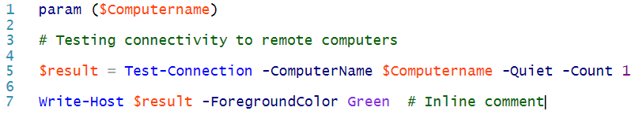
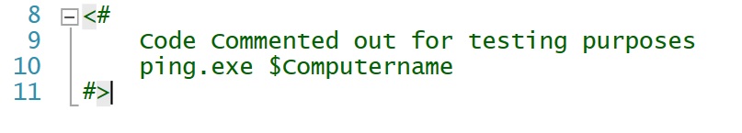
Comments
#
Comment character
<#
#>
Block comment tags
Notes:
KT: do we need this slide? Should we replace it with some tips on commenting?

Slide 10
Requires Statement
Special comment
Prevents script from running without required elements
Can only be used in scripts (not functions, cmdlets, etc)
Requires Option | Supported in PS Version
#Requires -Version <N>[.<n>] | 2.0+
#Requires -PSSnapin <PSSnapin-Name> [-Version <N>[.<n>]] | 2.0+
#Requires -ShellId <ShellId> | 2.0+
#Requires -Modules { <Module-Name> | <Hashtable> } | 3.0+
#Requires -RunAsAdministrator | 4.0+

Slide 11
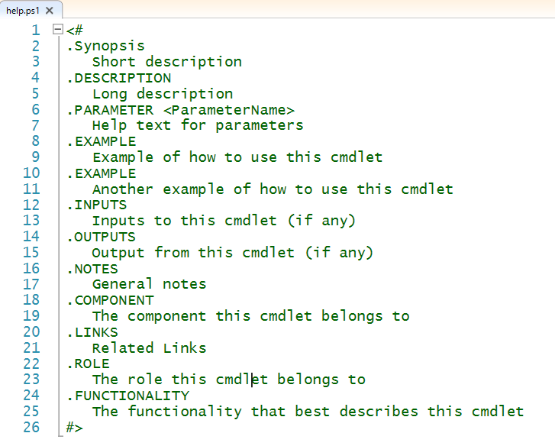
Function/Script Comment-based Help
<#
#>
Both Singe Line and Block Comments can be used.
#
PS C:\scripts> Get-Help .\help.ps1
NAME
C:\scripts\help.ps1
SYNOPSIS
Short description
SYNTAX
C:\scripts\help.ps1 [<CommonParameters>]
DESCRIPTION
Long description
[…]

Slide 12

Instructor Demonstration
DEMO
Statement Termination
Objective: Learn about Comments
Demo Content: Interactive Demo
Instructions: Open the Demo code and follow along while the instructor demonstrates the concepts. Do not feel that you have to keep up with the instructor, the code merely provided for review purposes. The concepts covered in the Demo code will also be re-visited in the “Fundamental Recap” during the Lab.
To Open the Demo Run:
PS C:\> Start-WPLUSLabs -Module Module_09 -Task Demo_01
Notes:
Demo: Function from script Dot source

Slide 13
Command Lookup Precedence
PowerShell rules that determine which command to run when there is more than one command with the same name
Note: If the same type of command with the same name exists, PowerShell runs the command that was added to the session most recently
Alias
Function
Cmdlet
External commands
Full Path (e.g. c:\scripts\BigFiles.ps1)

Slide 14
What is a Function?
Named Script Block
Reusable piece of Code
Can take arguments, known as Parameters
Must be defined before they can be used.
Function Keyword
Function Name
Matching Open/Close Curly Braces
Statement List
Use Function
1
2
function Do-Something { Write-Host “Do Something” } Do-Something
3
4
3
5
Notes:
A function is a named block of code that performs an action. When you type the function name, the code in the function runs.
Functions can return objects and data as well as executing code. Functions can also take parameters as input.
Functions must be defined in the script before they are called.
Scope (optional) ← Scopes are covered later in this workshop

Slide 15
Function Parameters
Define using param statement.
Used just like variables
Passed in using Dash notation.
Can have advanced attributes.
Param Statement
Matching Open/Close Paranthesis
Comma Separated Parameters
Use Just Like Variables
Pass into Function with Dash Notation
function Do-Something { param($Something) Write-Host $Something } Do-Something –Something “Hello”
1
2
3
2
4
5
Notes:
A function is a named block of code that performs an action. When you type the function name, the code in the function runs.
Functions can return objects and data as well as executing code. Functions can also take parameters as input.
Functions must be defined in the script before they are called.
Scope (optional) ← Scopes are covered later in this workshop

Slide 16
Instructor Demonstration
DEMO
Statement Termination
Objective: Learn about Functions
Demo Content: Interactive Demo
Instructions: Open the Demo code and follow along while the instructor demonstrates the concepts. Do not feel that you have to keep up with the instructor, the code merely provided for review purposes. The concepts covered in the Demo code will also be re-visited in the “Fundamental Recap” during the Lab.
To Open the Demo Run:
PS C:\> Start-WPLUSLabs -Module Module_09 -Task Demo_02
Notes:
SLIDE NOTES: change to this example:
function Sum-Files
{
$bytes = (dir -file -Recurse | measure -sum -Property length).Sum
$KB = $bytes / 1kb
write-host "$KB kbs" -ForegroundColor Green
}
function Sum-Files
{
param($Path)
$bytes = (dir -file -Recurse -Path $Path | measure -sum -Property length).Sum
$KB = $bytes / 1kb
write-host "$KB kbs" -ForegroundColor Green
}
function Sum-Files
{
param($Path = $pwd.path)
$bytes = (dir -file -Recurse -Path $Path | measure -sum -Property length).Sum
$KB = $bytes / 1kb
write-host "$KB kbs" -ForegroundColor Green
}

Slide 17
Scope Rules
Items are visible:
In scope where created & any child scope, unless explicitly made ‘private‘
Items are changed/created:
In current scope, unless scope overridden
Notes:
Slide notes: diagram using only function

Slide 18
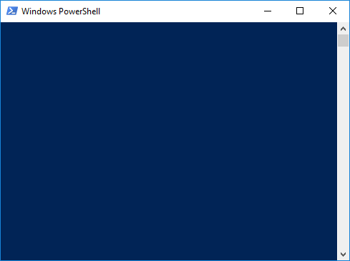
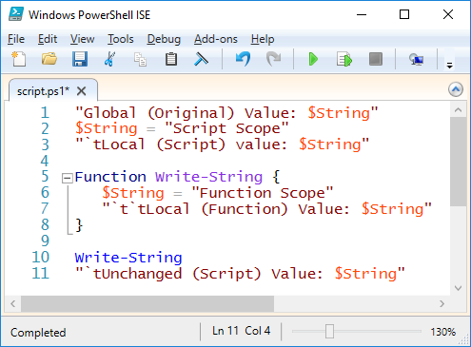
Demo: Scopes
Global Scope
PS C:\> $String = ‘Global Scope'
PS C:\> $String
Global Scope
PS C:\> C:\script.ps1
Global (Original) Value: Global Scope
Local (Script) Value: Script Scope
Local (Function) Value: Function Scope
Unchanged (Script) Value: Script Scope
PS C:\> $String
Global Scope
Script Scope
Variables remain unchanged by Child Scopes
Notes:
KT: this needs to be replaced with our normal demo slide or screenshots of the new demo
SLIDE NOTES: new demo bellow, take a screen shot for the slides, but do the following
$MyVariable #nothing exists!
function MyFunction
{
$myvariable = "goodbye"
$myvariable
}
MyFunction #$myVariable exists in the scope
$MyVariable #still doesn't exist
$MyVariable = "hello"
$MyVariable #now we have one
MyFunction #did it change?
$MyVariable #no, because that's the point of scopes
#explain that is they didn't exist, your variables would change values and it would be annoying
function MyFunction
{
$myvariable
$myvariable = "goodbye"
$myvariable
}
MyFunction #show it can see the parent
$MyVariable #still can't change it

Slide 19
Scope Modifiers
Scope Modifiers
Global | Highest level scope per host
Script | Nearest Script Scope
Local | Current Scope (Default)
Private | Current Scope, unavailable to children
[<scope-modifier>]:<name>
Examples
function global:Hello { write-host "Hello, World" }
$global:a = "one"

Slide 20
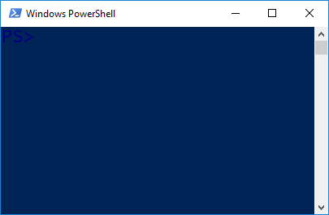
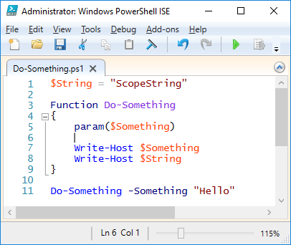
Scope Visualized
Console Scope
Scopes can use anything declared in current/parent scopes.
PS C:\Scripts\> .\Do-Something.ps1
Hello
ScopeString
PS C:\Scripts\>
Script Scope
Function Scope
The Script scope cannot use things defined in the Console Scope and things from the Script scope do not remain, unless script is called using dot-sourcing.

Slide 21
Dot-Source Notation
By default, child scope created when script or function runs
Dot-source does not create a child scope
Script or function runs in current scope and creates items in current scope
Item visibility does not terminate with the script or function
Notes:
Slide notes: add screen shot
NEM: Should we discuss Dot Source with Scopes (which is in previous module)? It would be easier to explain how changes do not reflect from child to parent scope but through dot source can achieve it.
Suggestion: Scopes+Dot Source -> One Topic in One Module.

Slide 22
Dot Sourcing Visualized
Dot Sourcing does not create a Child Scope
Console Scope
PS C:\Scripts\> . .\Do-Something.ps1
Hello
ScopeString
PS C:\Scripts\>
Function Scope
The Dot Sourcing operator is the “. “ (Dot Space)
This can look odd when using Relative Paths

Slide 23
Instructor Demonstration
DEMO
Statement Termination
Objective: Learn about Scopes
Demo Content: Interactive Demo
Instructions: Open the Demo code and follow along while the instructor demonstrates the concepts. Do not feel that you have to keep up with the instructor, the code merely provided for review purposes. The concepts covered in the Demo code will also be re-visited in the “Fundamental Recap” during the Lab.
To Open the Demo Run:
PS C:\> Start-WPLUSLabs -Module Module_09 -Task Demo_03
Notes:
Take previous example and use global
function MyFunction
{
$global:myvariable = "goodbye"
$myvariable
}
$myvariable

Slide 24
Profiles
Start-up script that runs every time PowerShell starts.
Can be prevented using -noprofile
Any valid PowerShell script can be in profile
Profiles not exempt from execution policy
Four possible profile scripts for host
Additional profiles available for ISE.
Can be accessed using $Profile Automatic Variable.
The profile script contents are “dot-sourced”
Start PowerShell
Execute Profile Scripts
$Profile.AllUsersAllHosts
$Profile.AllUsersCurrentHost
$Profile.CurrentUserAllHosts
$Profile.CurrentUserCurrentHost
Execute Prompt Function
PS C:/>

Slide 25
Profile Paths
Common to ISE and Console
Scope | Path
Current User, All Hosts | $Home\Documents\WindowsPowerShell\profile.ps1
All Users, All Hosts | $PsHome\profile.ps1
Console Only Profile Paths
Current User, Current Host | $Home\Documents\WindowsPowerShell\Microsoft.PowerShell_profile.ps1
All Users, Current Host | $PsHome\Microsoft.PowerShell_profile.ps1
ISE Only Profile Paths
Current User, Current Host | $Home\Documents\WindowsPowerShell\Microsoft.PowerShellISE_profile.ps1
All Users, Current Host | $PsHome\Microsoft.PowerShellISE_profile.ps1

Slide 26
Listing Profile Paths
PS C:\> $profile | Format-List -Property * -Force
AllUsersAllHosts : C:\Windows\System32\WindowsPowerShell\v1.0\profile.ps1
AllUsersCurrentHost : C:\Windows\System32\WindowsPowerShell\v1.0\Microsoft.P
owerShellISE_profile.ps1
CurrentUserAllHosts : C:\Users\Administrator\Documents\WindowsPowerShell\profile.
ps1
CurrentUserCurrentHost : C:\Users\Administrator\Documents\WindowsPowerShell\Microsof
t.PowerShellISE_profile.ps1
Length : 81

Slide 27
Instructor Demonstration
DEMO
Statement Termination
Objective: Learn about Profiles
Demo Content: Interactive Demo in the ISE
Instructions: Open the Demo code and follow along while the instructor demonstrates the concepts. Do not feel that you have to keep up with the instructor, the code merely provided for review purposes. The concepts covered in the Demo code will also be re-visited in the “Fundamental Recap” during the Lab.
To Open the Demo Run:
PS C:\> Start-WPLUSLabs -Module Module_09 -Task Demo_04
Notes:
PS C:\> ping 2012r2-ms
Pinging 2012r2-ms.contoso.com [10.0.1.210] with 32 bytes of data:
Reply from 10.0.1.210: bytes=32 time<1ms TTL=128
Reply from 10.0.1.210: bytes=32 time<1ms TTL=128
Reply from 10.0.1.210: bytes=32 time<1ms TTL=128
Reply from 10.0.1.210: bytes=32 time<1ms TTL=128
Ping statistics for 10.0.1.210:
Packets: Sent = 4, Received = 4, Lost = 0 (0% loss),
Approximate round trip times in milli-seconds:
Minimum = 0ms, Maximum = 0ms, Average = 0ms
PS C:\> New-Alias -Name ping -Value Test-Connection
PS C:\> ping 2012r2-ms
Source Destination IPV4Address IPV6Address
------ ----------- ----------- -----------
WIN8-WS 2012r2-ms 10.0.1.210
WIN8-WS 2012r2-ms 10.0.1.210
WIN8-WS 2012r2-ms 10.0.1.210
WIN8-WS 2012r2-ms 10.0.1.210

Slide 28
Scripts
Lab Content: Interactive Demos/Labs
Instructions: Open the Lab code and perform the operations at your own pace. Afterwards you may review the Demos again until the next block of instruction begins.
To Open the Lab Run:
Lab
PS C:\> Start-WPLUSLabs -Module Module_10 -Task Lab_01
Notes:
Fundamental Recap (From Demo Content):
Lab:
Functions: Various prompt stuff (lab)
Scopes: function in a function (can’t use it), then add global modifier

